Slide 1
E-GRIEVANCE REDRESSAL SERVICE
GUIDED BY
Mr. R. BALAJI M.E
CARRIED BY
A. SIVARAJESH -11BC097
S. SHYAM SHANKAR -11BC095
S. PRASANTH -11BC066
M. PRAVEEN -11BC068

Slide 2
Base Paper
Efficient Complaint Registration using Mobile Interface;
Soujanya V, Amrutha S, Ashwini P and Rajeshwari;
International journey of innovatory research in science and management; Volume 1, Issue 1, May 2014

Slide 3
Problem Description
Elicitation and handling complaint is one of the challenges and responsibility by the Municipal Corporation (MC) or local governing body within the town limit.
By using smart mobile we can solve this problem, so that authorized persons can response immediately, hence it improves the quality of services of the MC.

Slide 4
Grievance
Public have the right to complaint or give comments on the services and facilities provided.
Unfortunately, in most of the cases public face difficulties to channel their complaints and comments to the right party.
The public also have difficulties in knowing the status of their complaints.

Slide 5
Grievance (Contd)
It is important to know the use and efficiency of services that are provided by the Municipal Corporation using latest and better technologies.
There have also been research which address the uses of e-services for physically challenged citizens.
E-services were used in Europe for a while, but they have been extensively attracting far use up in India, in a big way in large cities (like Mumbai, Bangalore etc.).

Slide 6
Grievance (Contd)
The system aim is to analyze and maintenance of the complaint within the corporation area.
By using the Mobile Complaint interface, citizens can lodge the complaints 24 × 7 or around the clock.
The response regarding the complaints is fetched from the Government Officer (GO) and it is made display to the user.
The essential idea is to make use of the existing web portal infrastructure and provide an easy, cheap and quick mode of complaint registration and complaint processing.

Slide 7
Objective
To provide an e-service for the complaint processing system,
To design an android application which allows the public to register their complaints.
To design a console to allow the government bodies to view the list of complaints and their details in their sector and process it.
To make volunteer participation of public to make an effort to solve the social problems.

Slide 8
Existing System
In the Existing System people have to visit the organization whenever they have any Complaints regarding the social problems.
Whenever a public find any problems such as damages in roads, unclosed drainages and damaged electrical lines, he/she is required to move to the corresponding organization or the respective office.
He/she has to write a complaint letter which describes the entire problem and submit it to appropriate officer.

Slide 9
Limitations in Existing System
The people need to visit the organization and it consumes more time.
The complete current system is a manual system and therefore it is very slow in process.
Public details are not secured here so they might face any political problem.
Clemency for the challenged people are not considered here, they can’t make a visit to the appropriate offices

Slide 10
Proposed System
The system makes use of the already available web portal infrastructure as complaint processing platform and assist user to file their complaint using their smart phone.
The complaint is then forward to appropriate department or organizational officer.
Then the response from the department is then fetched and sent back to the user.
The status about the complaint is periodically checked and updated to the user.

Slide 11
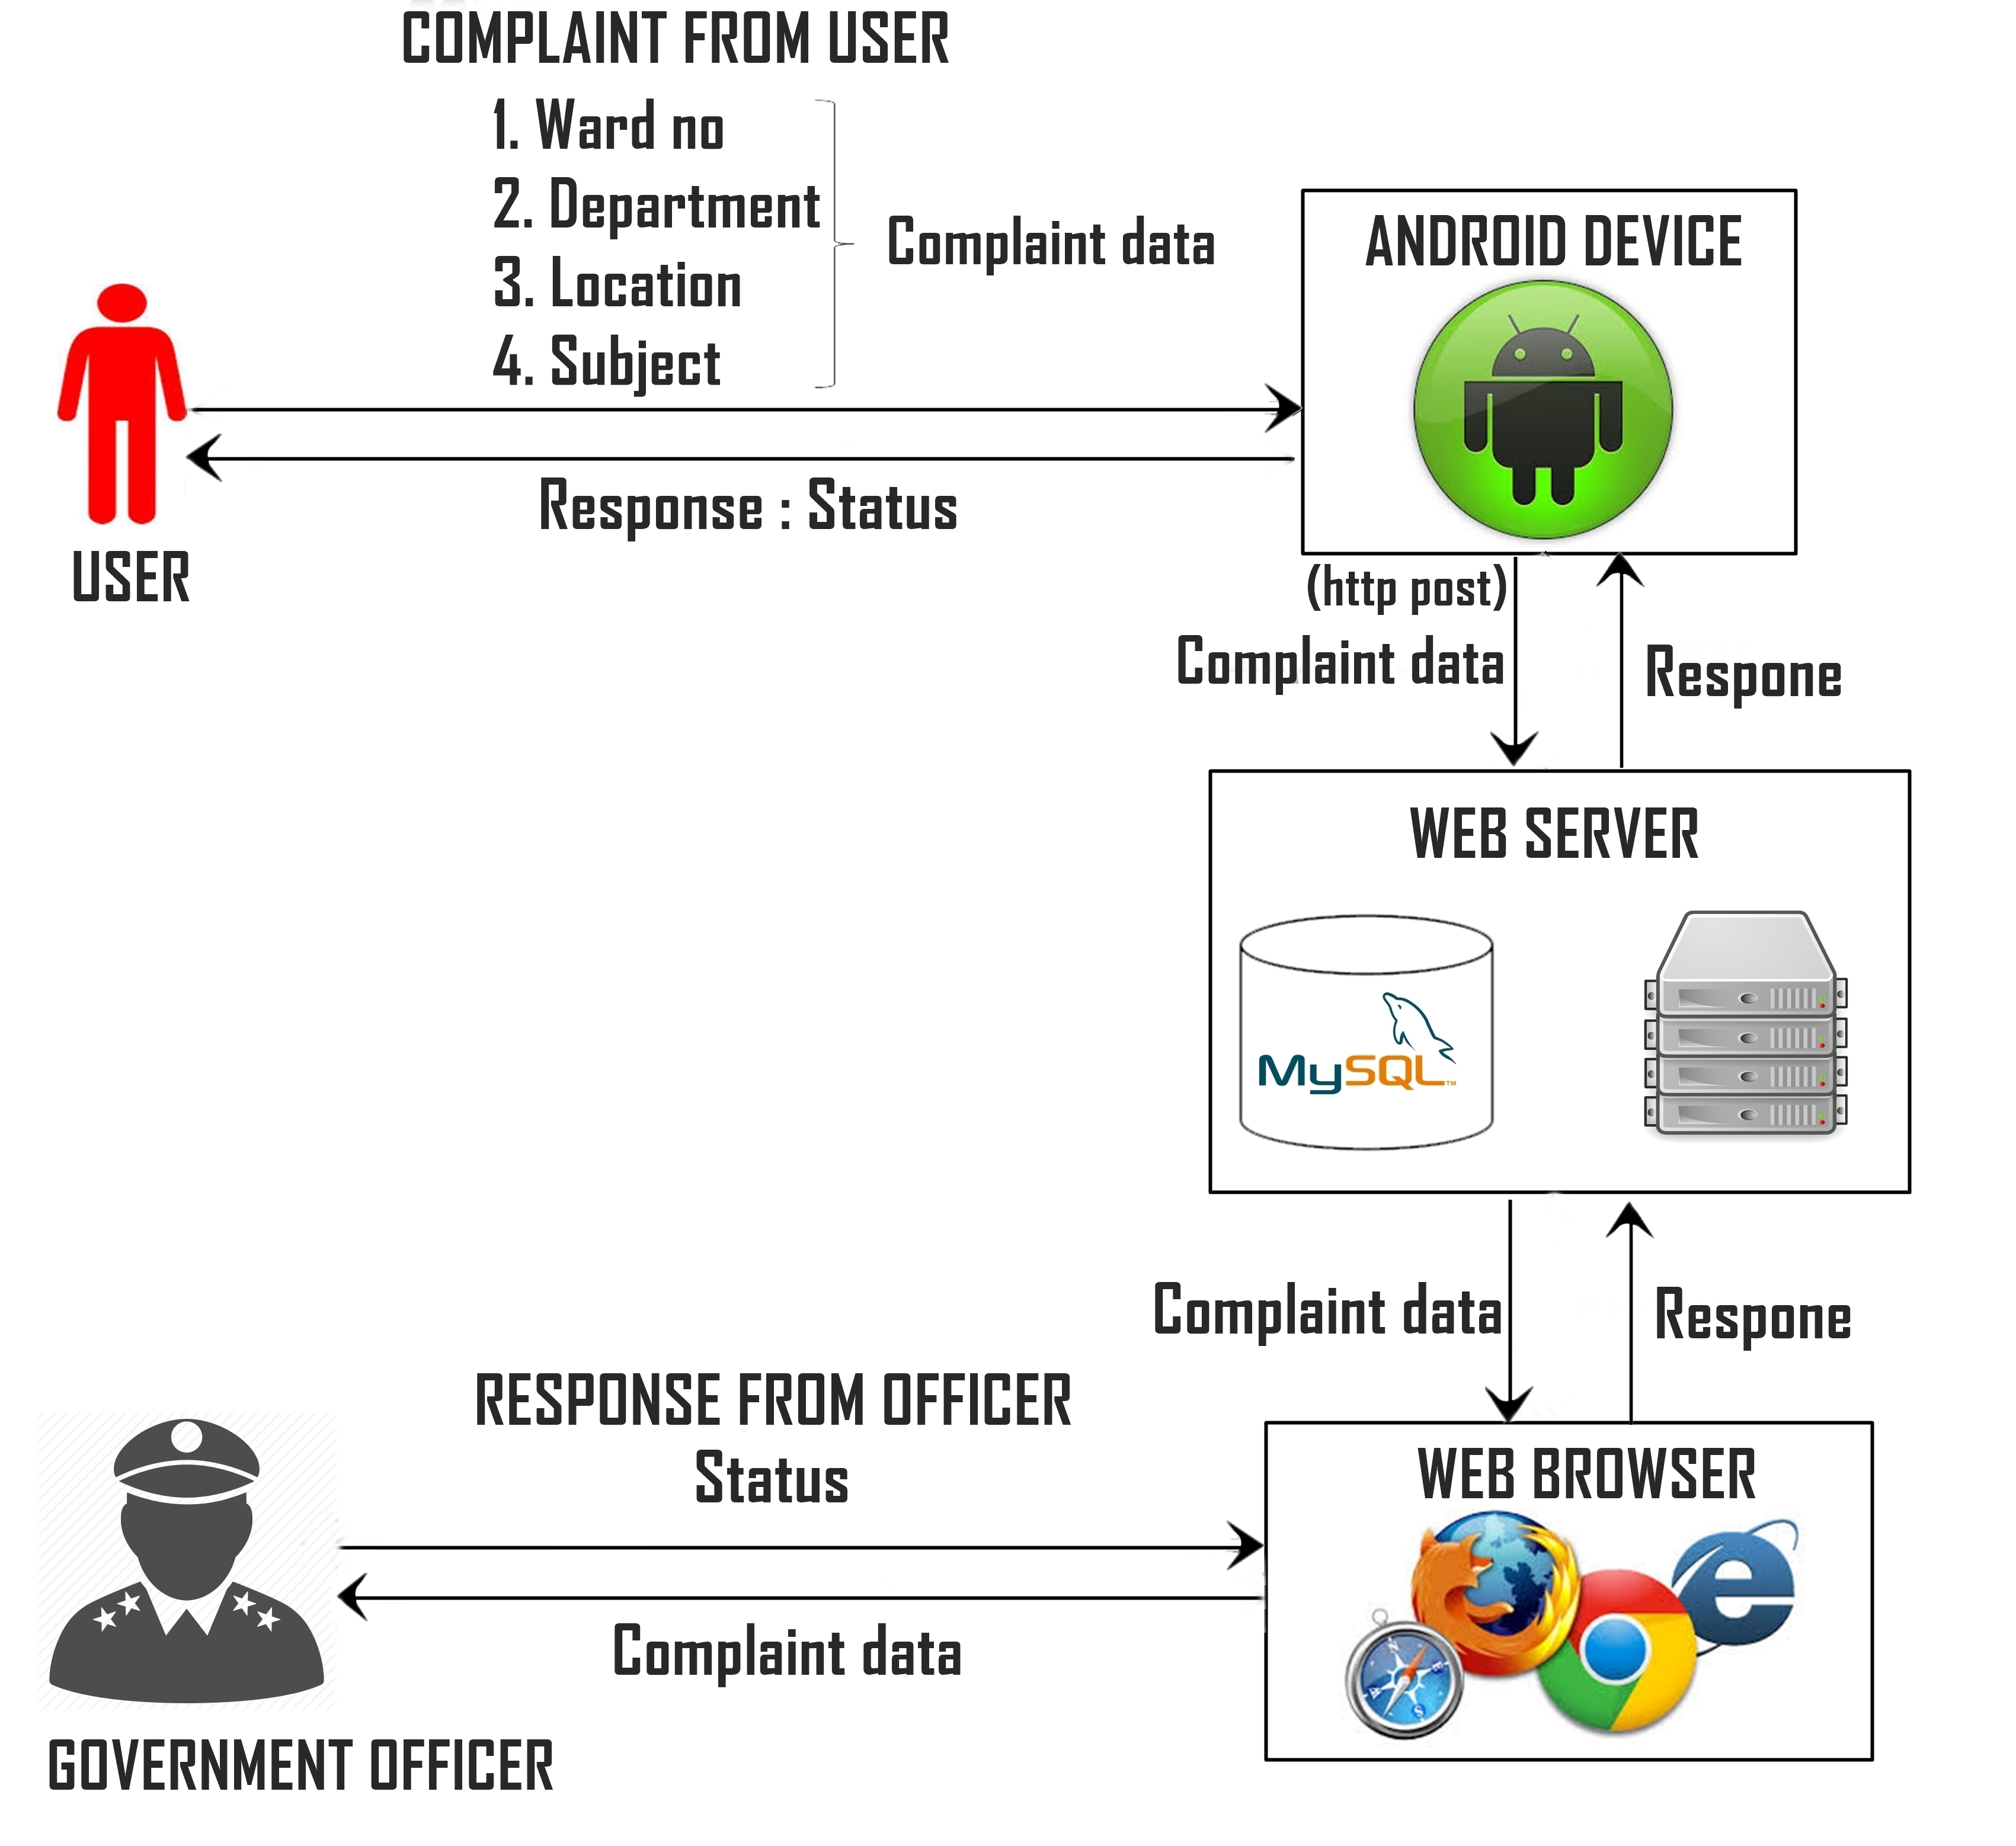
Architecture of proposed system

Slide 12
Advantages of proposed system
There is no need to visit the organization regarding complaint registration.
Proposed system is fully automated.
It doesn’t consume more time.
The user information is secured here.
Clemency for the challenged people are considered here

Slide 13
Modules
User registration
Complaint registration
Complaint forwarding
Status update

Slide 14
User registration
The registration process is the first time participation of the user where the user enters their details and credentials also a password of the user’s choice is got for further authentication.
During the registration user is asked to enter an ID proof number such as license, voter ID in order to know that he is a genuine Indian citizen.
The system keeps the user information highly confidential in order to avoid harm to the user.
User provides the username and password for authentication in the login form.

Slide 15
Complaint Registration
Whenever the public face any problem they can register their problem here with the required information as follows.
Upload the picture of the problem situation such as opened drainage, damaged roads etc.,
Subject to the problem
Required to choose the category.
A brief description about the problem.
Exact location where the problem occurs.

Slide 16
Complaint forwarding
The registered complaints are updated in the server database.
While officer login, his/her credentials are get and it’s send to the appropriate php file.
The officer chooses the department while he login.
The complaints regarding appropriate departments will be fetched from the database and made visible to the officer.
Therefore the officer can know the problems which are faced by public so that he can take steps to resolve the social problems.

Slide 17
Status update
The officer can view the complaints which are registered in the server.
He/she can replay to the complaints such as reason for the delay or when it’ll be resolved.
The officer’s response is then display to the user so that he can know what’s the process is going on regarding the issue.

Slide 18
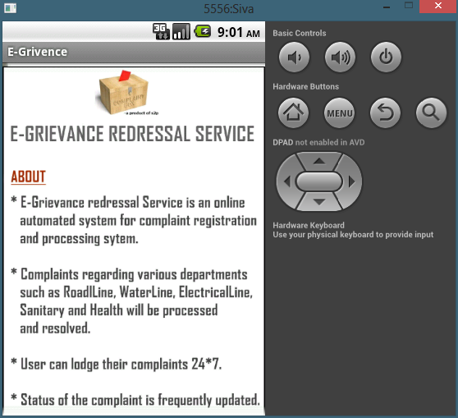
Start Screen

Slide 19
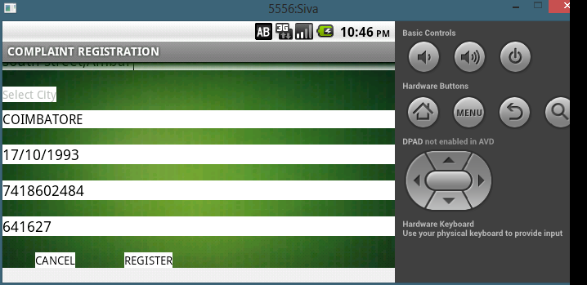
User registration form

Slide 20
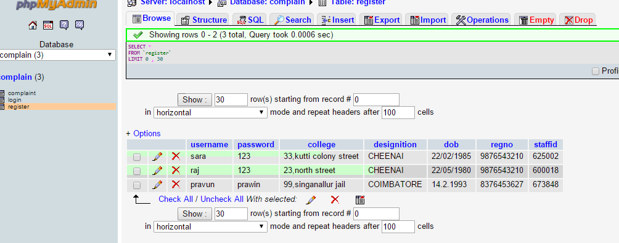
User table

Slide 21
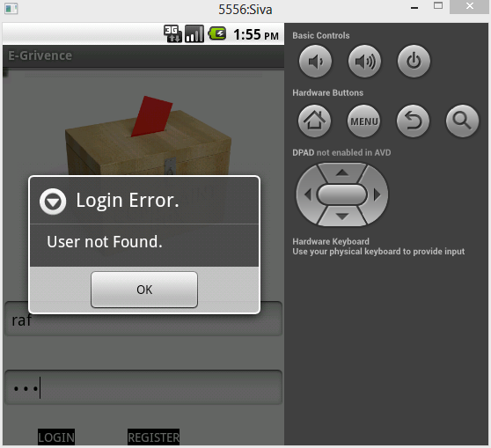
Login verification

Slide 22
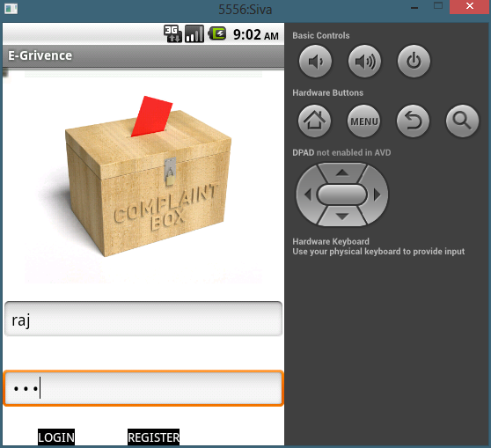
Login page

Slide 23
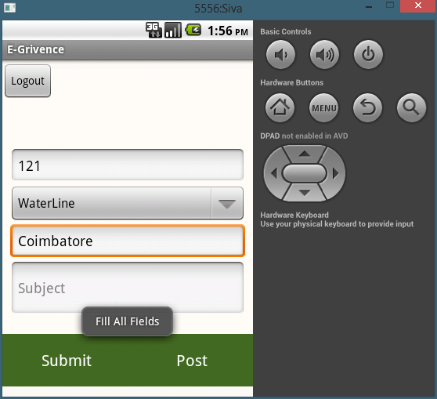
Complaint registration form validation

Slide 24
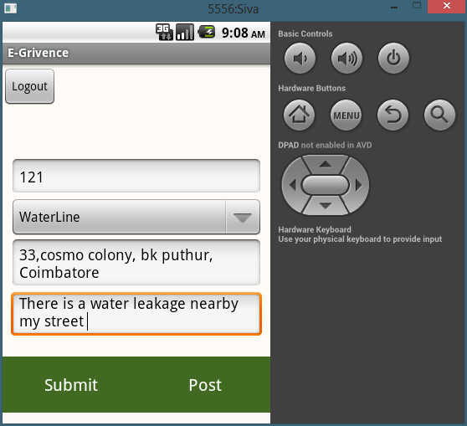
Complaint registration form

Slide 25
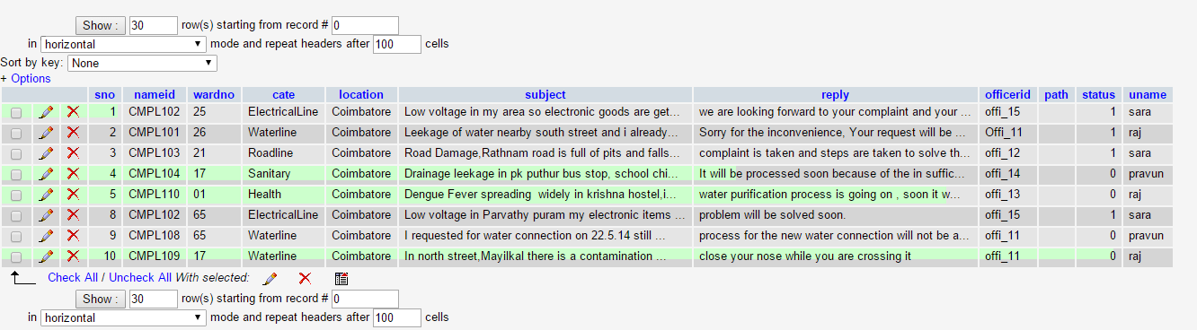
Complaint table

Slide 26
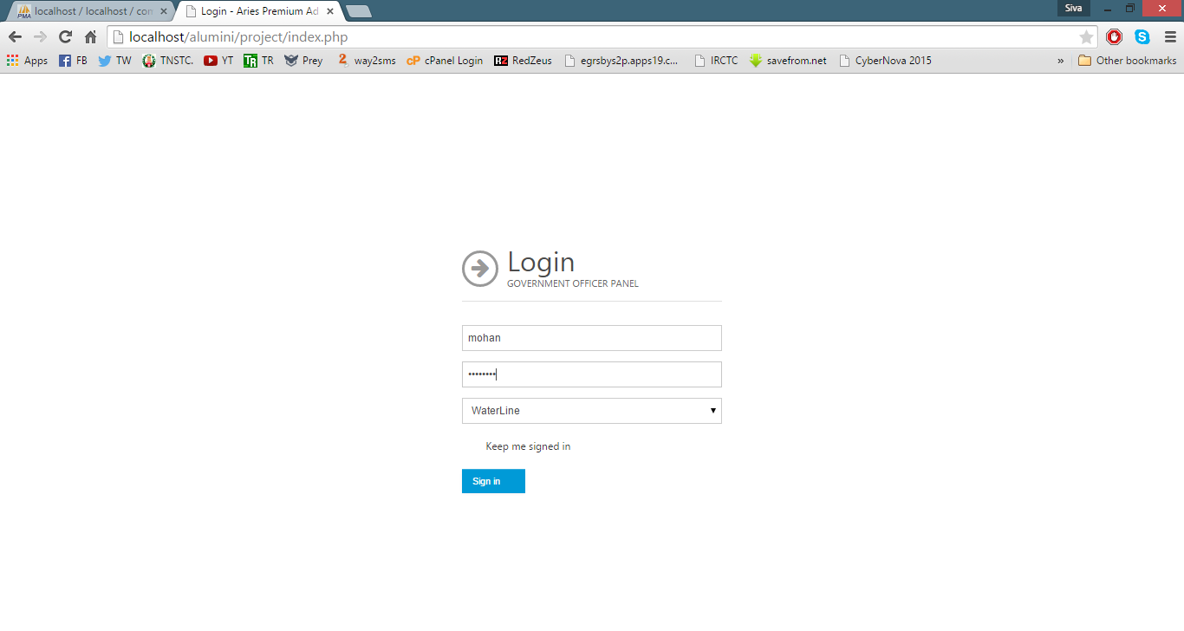
Officer login page

Slide 27
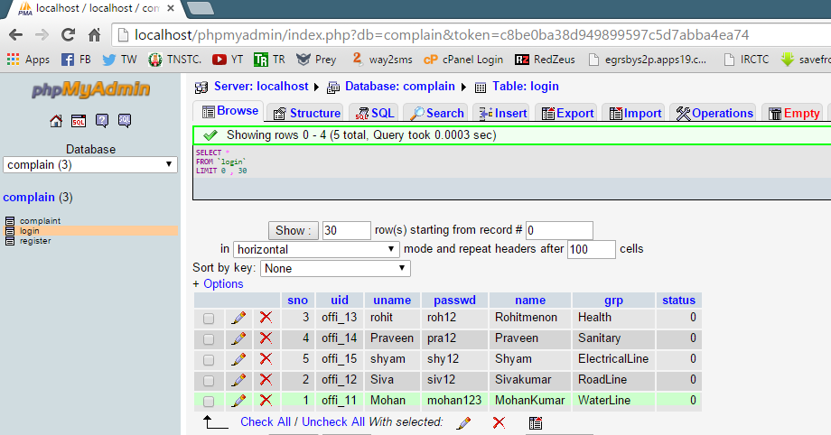
Officer table

Slide 28
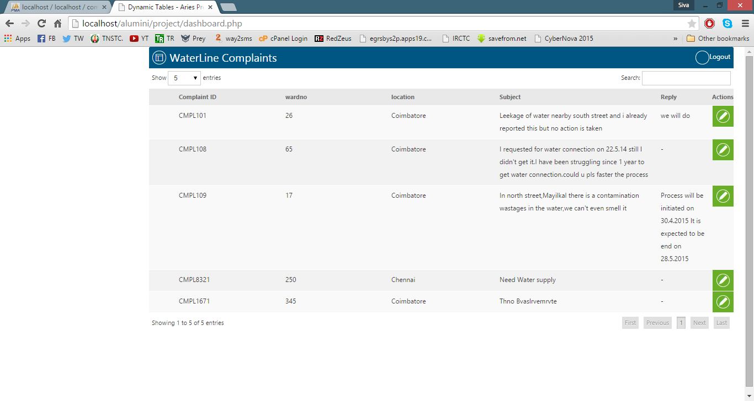
Complaint view panel

Slide 29
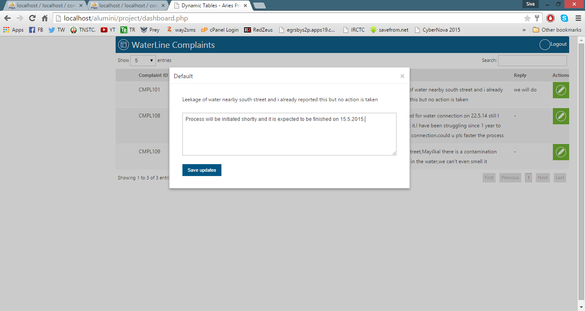
Status update

Slide 30
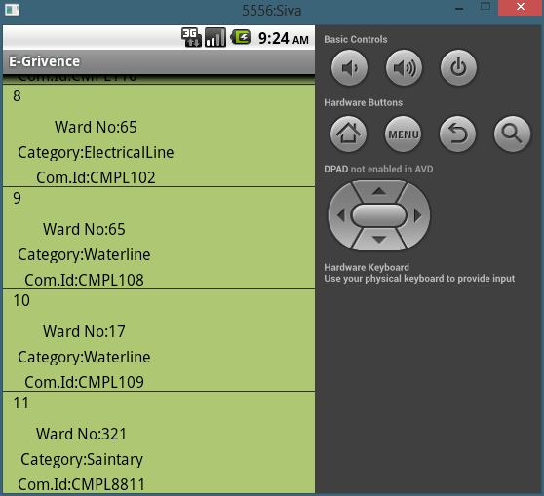
Registered Complaints

Slide 31
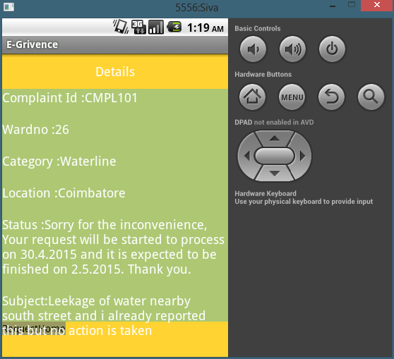
Status View

Slide 32
Conclusion
E-Grievance redressal service system is proposed and built for users to lodge complaints about their city.
This system analysis and maintains the complaint with in the corporation area.
The system is accessible to everyone who has a smart phone, he/she can download this application and register their complaint all around the clock.
The fully automated complaint registration service makes people to come forward to solve social problems
The essential idea is to make use of the existing web portal infrastructure and provide an easy, cheap and quick mode of complaint registration and getting responses.

Slide 33
Reference
Chaumon, B. and Guermond. S. Study of conditions of use of e-services accessible to visually disabled persons. In Proceedings DEGAS 2007.
Mun, M., Sokij, T “PEIR, the Personal Environmental Impact Report, as a Platform for Participatory Sensing Systems Research,” Proc. 7th Int’l. Conf. Mobile Systems, Applications, and Services, June 2009.
B.P. Vuurens , "Obtaining High-Quality Relevance Judgments Using Crowdsourcing,"Sept.-Oct. 2012.
R. K. Ganti et al., “Mobile Crowd sensing: Current State and Future Challenges,” 2011

Slide 34
Thank You

